Slide 1

DEEP LEARNING IN SPEECH RECOGNITION ADVANCE MACHINE LEARNING
GOWTHAM CHAKRI MALLEPAKA
811240979

Slide 2
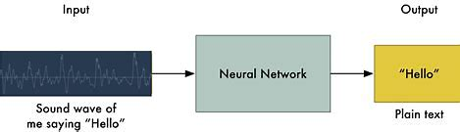
INTRODUCTION
Speech recognition is the process of converting spoken language into text using AI and computer science. Deep learning is a popular method for improving the accuracy and reliability of speech recognition systems. Speech signals are usually processed using RNNs or CNNs, and represented as spectrograms or MFCCs. DNN-HMM is a widely used model for speech recognition, which combines deep neural networks with traditional HMMs to capture both temporal and spectral features of speech.
Other approaches include end-to-end models and hybrid models. Speech recognition has practical applications in areas such as voice assistants, dictation software, and transcription services.

Slide 3
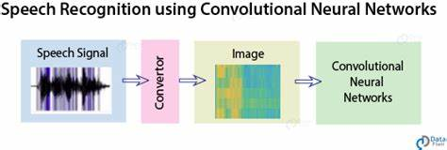
METHODS USED
CNN
In particular, CNNs have been utilized successfully in acoustic modeling, which converts audio inputs into phonemes, in speech recognition. Because of its ability to extract valuable information from audio sources using convolutional and pooling layers, CNNs are excellent in this. In voice recognition applications, time-delay neural networks are a popular CNN-based design. They are frequently utilized in cutting-edge systems and have showed promise in boosting accuracy.

Slide 4
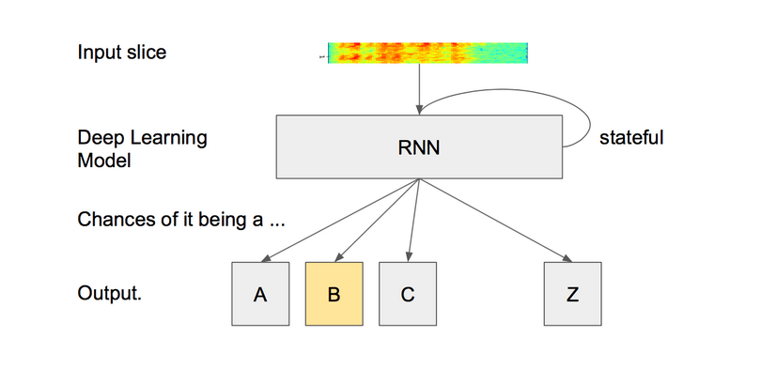
RNN Due to its capacity to process sequential input, which is necessary for processing speech signals, recurrent neural networks (RNNs) have been widely used in speech recognition. RNNs are a sort of neural network that can deal with input sequences of various lengths and learn to capture temporal dependencies in the input data

Slide 5
APPLICATION WHERE THIS COULD BE USED
Healthcare
Deep learning-based voice recognition has several uses in the financial, customer service, and automotive industries as well as in healthcare for medical transcription and diagnostics as well as for activities including transcribing, automation, and safety.
Transportation: Deep learning-based voice recognition is utilized in the transportation industry to provide directions and allow hands-free management of vehicle functions without endangering other road users.
Security: Security use deep learning-based voice recognition to verify a person's identification and deter criminality

Slide 6
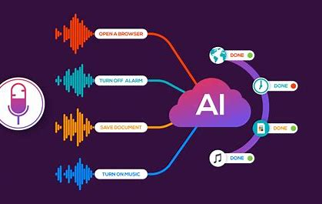
Future development
There are potential future developments in speech recognition applications called virtual assistants. The major challenge that we face is about the variation in voice, tone, language and even accents. So, the future development shall be that the VAs starts processing various languages and patterns with greater accuracy. Transcription of the speech shall be more accurate with robust technologies in place . Of course, deep learning techniques have emerged as a savior to this application, the advancement in RNN and CNN can also develop the performance of such applications.

Slide 7
LIMITATIONS
Accuracy:
Vocabulary restriction
Real-time processing
Requirements for training:
Speech recognition systems
SOLUTION
Enhancing audio quality
Language models
Speaker diarization
Adaptive learning
Hybrid methods
Contextualization

Slide 8
THANK YOU

